Slide 1
MEDICINAL PLANTS IDENTIFICATION WITH ENHANCED AUTHENTICITY BY IMAGE PROCESSING USING
DEEP LEARNING TECHNIQUES AND SUPPLY CHAIN INTEGRITY
MENTOR
Dr.V. Karthick,M.E.,Ph.D.,
Associate Professor,
Department of CSE,
Rajalakshmi Engineering College,Chennai
TEAM MEMBERS
VARUNESH B 210701303
VINOTH N 210701311
UDHAYACHANDER R J 210701294

Slide 2
ABSTRACT
The Proposed System utilizes Convolutional Neural network(CNN) image processing algorithm and accurately identify the medicinal plants based on their visual characteristics with enhanced authentication and implementing the supply chain integrity for the identified Medicinal plants to enhance common people identification and awareness.
Keywords:CNN,Supply chain Integrity,Image processing,authentication.

Slide 3
INTRODUCTION
The proposed system employs deep learning techniques to accurately identify medicinal plants through advanced image processing. By integrating these identification capabilities with comprehensive supply chain integrity measures, the initiative aims to ensure the authenticity and traceability of medicinal plant products, enhancing their reliability and safety from harvest to consumer.

Slide 4
LITERATURE REVIEW
S.NO | TITLE | AUTHORS | JOURNAL | YEAR | CONTRIBUTION | LIMITATION
1. | A Study of CNN and Its Impact on Global Communication | I.Volkmer | IEEE | 2022 | Contributed on the impacts of CNN algorithm efficiency | It doesn’t specifies the edge cases in CNN
2. | Software Supply Chain Security | C. Crossley | IEEE | 2024 | Gave crisp Idea on the supply chain technique. | Security content is less covered

Slide 5
LITERATURE REVIEW
S.NO | TITLE | AUTHORS | JOURNAL | YEAR | CONTRIBUTION | LIMITATION
3. | Blockchain-based Medical Image Encryption Using Arnold's Cat Map in a Cloud Environment | S. Inam, S. Kanwal, R. Firdous | IEEE | 2024 | Contributed on the effective techniques in blockchain security | It doesn’t specifies the Advanced encryption factors
4. | Herbal Leaves Classification Based on Leaf Image Using CNN Architecture Model VGG16 | Oktaviana, Wicakson | IEEE | 2023 | VGG16 is deeply explained in this paper | Much more Insights on the CNN is expected

Slide 6
LITERATURE REVIEW
S.NO | TITLE | AUTHORS | JOURNAL | YEAR | CONTRIBUTION | LIMITATION
5. | Comparison of Data Preprocessing Approaches for Applying Deep Learning to Human Activity Recognition in the Context of Industry 4.0 | X. Zheng, M. Wang | IEEE | 2020 | Contributed on the Data preprocessing techniques explanation | It doesn’t cover the edge cases in Dataset processing
6. | Classification of Medicinal Plants Leaves Using Deep Learning Technique | H. Chanyal, R.K. Yadav | IEEE | 2022 | Deep learning technique is discussed deeply in paper | Doesn’t specify the need of upgraded algorithms

Slide 7
LITERATURE REVIEW
S.NO | TITLE | AUTHORS | JOURNAL | YEAR | CONTRIBUTION | LIMITATION
7. | A Five-Layer Deep Convolutional Neural Network with Stochastic Pooling for Chest CT-based COVID-19 Diagnosis | YD Zhang, SC Satapathy, S Liu | IEEE | 2022 | Gave deep insights on the Five layer CNN techniques | It doesn’t cover the edge cases in VGG16 model
8. | Authenticity and Authentication of Heritage:A Review | D. Chhabra | IEEE | 2021 | Authentication technique is discussed deeply in paper | Doesn’t specify the need of Encryption algorithms

Slide 8
LITERATURE REVIEW
S.NO | TITLE | AUTHORS | JOURNAL | YEAR | CONTRIBUTION | LIMITATION
9. | A Survey on Different Methods for Medicinal Plants Identification and Classification System | Maibam Maikel Singh, Thounaoja RupachanSingh | IEEE | 2021 | Explained with real time examples on classification | Survey has less authenticity compared to existing model.
10. | Blockchain Integration for Medicinal Plant Supply Chain Integrity | P. Zhao ,T. Clark | IEEE | 2022 | Deep Insights on the Blockchain Technology | Lacks in Integration part of Supply chain.

Slide 9
EXISTING SYSTEM
The existing system uses deep learning algorithms, the system employs image processing techniques to accurately identify medicinal plants, ensuring authenticity with accuracy of 96.12% but the dataset used to train contains only 10 classes of medicinal plants. By analyzing intricate features of plant images,the system can distinguish between different species with average precision, reduces the risks associated with misidentification.There is no verification and authentication of the medicinal plants products.

Slide 10
RESEARCH GAP
The existing system uses deep learning algorithms, the system employs image processing techniques to accurately identify medicinal plants, ensuring authenticity with accuracy of 96.12% .
The dataset used to train contains only 10 classes of medicinal plants. The system can distinguish between different species with precision, increases the risks associated with misidentification to training with less dataset.
There is no verification and authentication of the medicinal plants products .

Slide 11
PROPOSED SYSTEM
The Proposed system uses cutting-edge deep learning algorithms, the system employs image processing techniques to accurately identify medicinal plants, ensuring authenticity by using dataset of more than 100 classes of medicinal plants with the accuracy of 97.97%.The integration of supply chain integrity mechanisms ensures transparency and traceability of products. The system not only safeguards the integrity of medicinal plant products but also fosters trust among consumers and promotes sustainable practices within the industry.

Slide 12
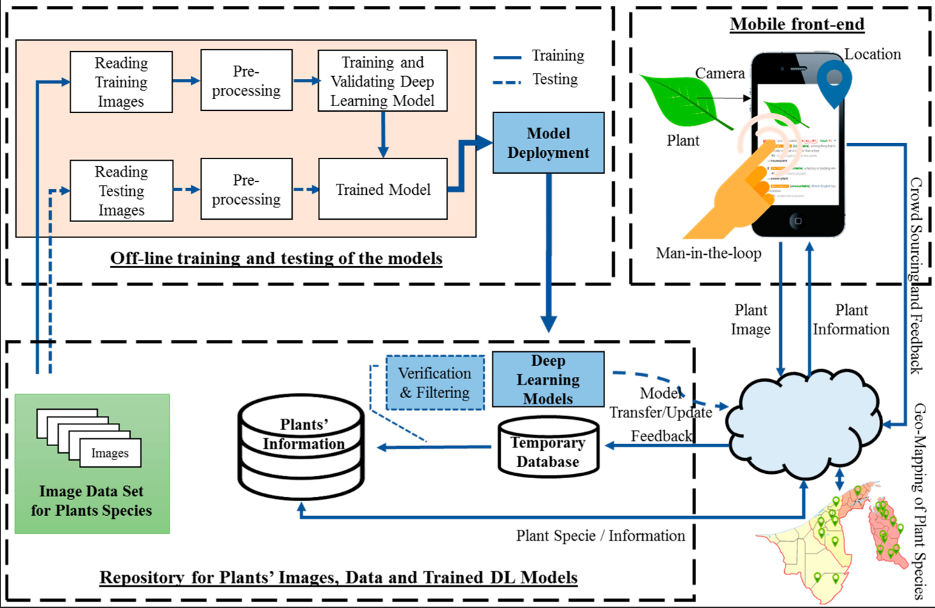
SYSTEM ARCHITECTURE

Slide 13
RESULTS AND DISCUSSION
The implementation of a Medicinal Plants Identification by Image Processing Using Deep Learning Techniques and Implementing Supply Chain Integrity utilizing CNN Algorithm represents a remarkable result by achieving 97.97% accuracy in identifying medicinal plants,whereas existing system gives only 96.12%.By delivering dependable and efficient quality assurance and traceability solutions,the proposed model helps to promote consumer health, encourage sustainable herbal medical practices, and reduce fraudulent activity in the herbal supply chain.

Slide 14
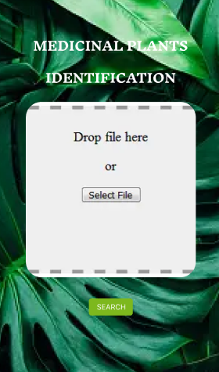
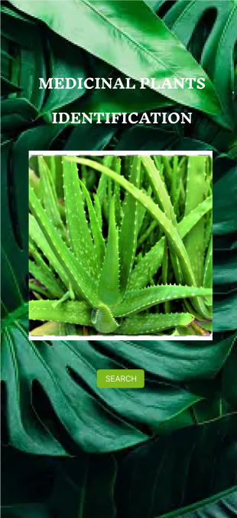
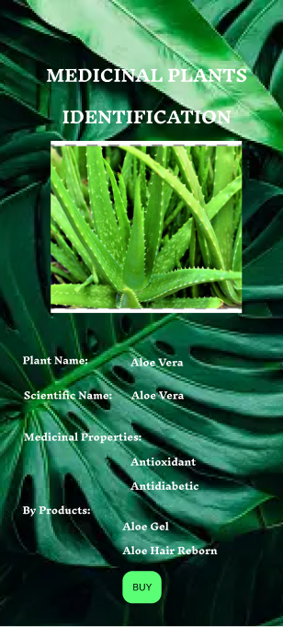

IMPLEMENTATION PROTOTYPE

Slide 15
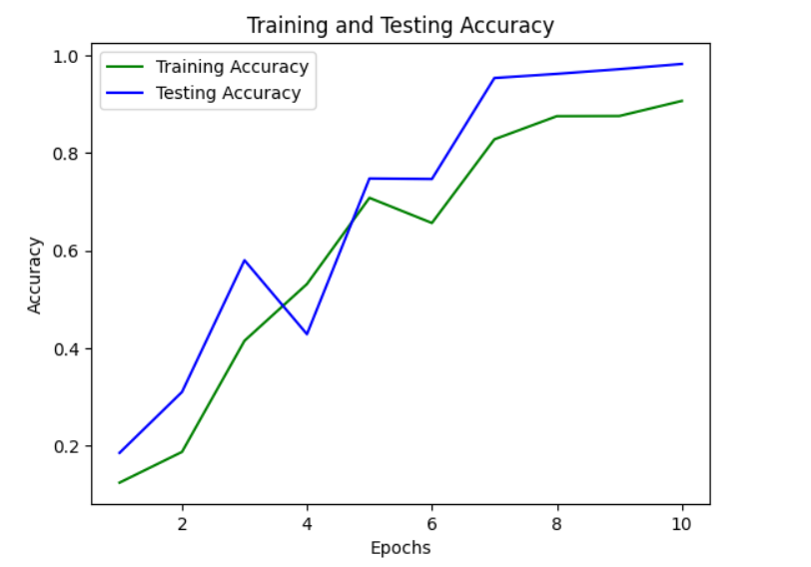
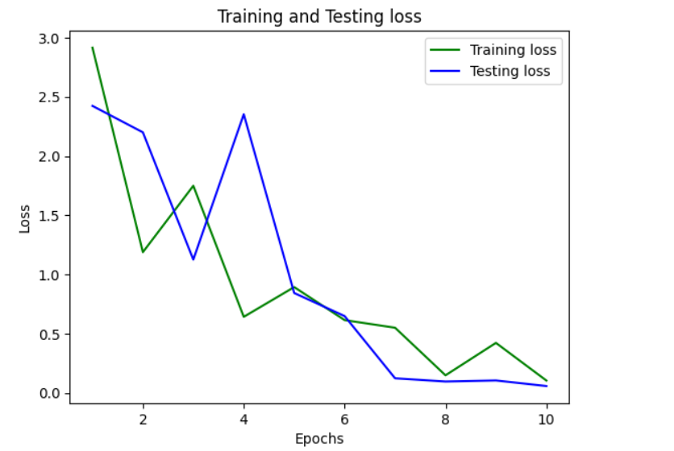
TRAINING AND TESTING GRAPHS

Slide 16
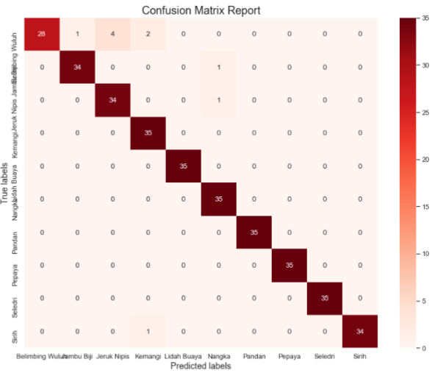
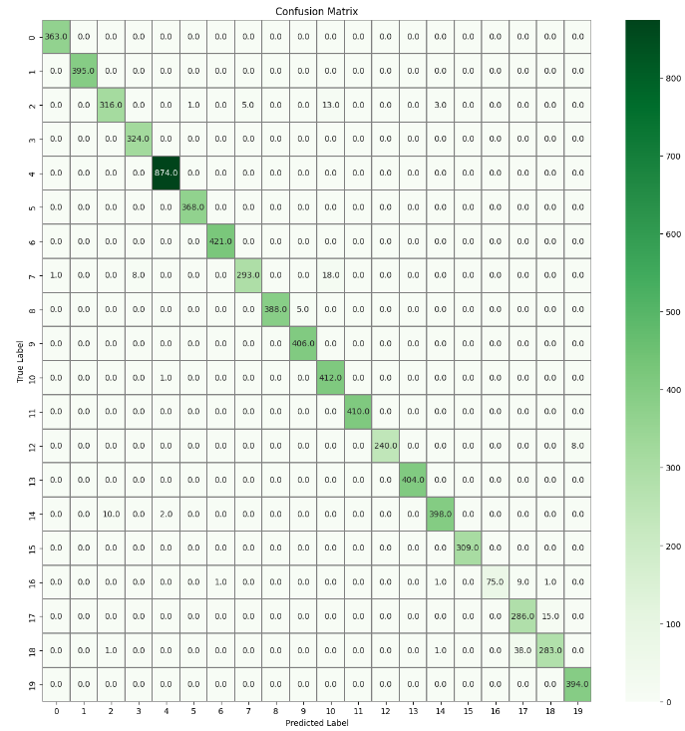
COMPARATIVE ANALYSIS
EXISTING SYSTEM
PROPOSED SYSTEM

Slide 17
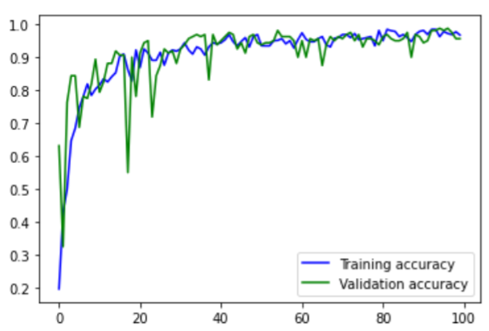
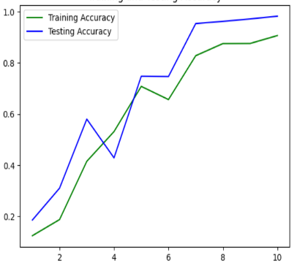
COMPARATIVE ANALYSIS
EXISTING SYSTEM
PROPOSED SYSTEM

Slide 18
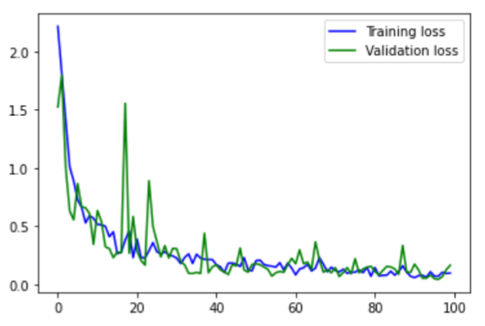
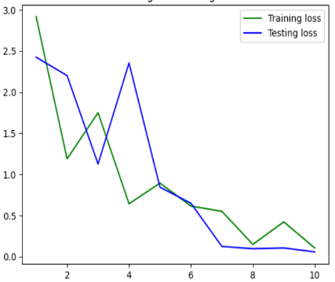
COMPARATIVE ANALYSIS
EXISTING SYSTEM
PROPOSED SYSTEM

Slide 19
COMPARATIVE ANALYSIS
MODEL | ACCURACY
MEDICINAL PLANTS CNN [10 CLASSES] | 96.12
MEDICINAL PLANTS CNN [20 CLASSES] | 97.97

Slide 20
CONCLUSION
The proposed model is an important step forward in the fields of herbal medicine and supply chain management. The proposed idea effectively addressed significant difficulties in medicinal plant identification, authenticity verification, and supply chain transparency by combining cutting-edge technologies such as image processing, deep learning, and supply chain.The proposed approach has exhibited extraordinary accuracy, reaching a 97.97% identification rate for medicinal plants using visual characteristics retrieved from photos.Greatly paves the way for pharmaceutical industry and Global Marketing.

Slide 21
FUTURE ENHANCEMENTS
Integration of IoT Devices
Integrating IoT devices in the supply chain as future enhancement paves the way to monitor and record environmental conditions during plants surplus conditions as stocks and transportation for Supply Chain mechanisms.
Crowdsourced Verification
Enhancing a platform for crowdsourced verification where users can contribute to verifying the correctness of plant identifications,which leads to better understanding of the identification.

Slide 22
REFERENCES
[1] I. Volkmer, News in the Global Sphere: A Study of CNN and Its Impact on Global Communication. Indiana University Press, 1999
[2] S. Inam, S. Kanwal, R. Firdous, and F. Hajjej, “Blockchain based medical image encryption using Arnold’s cat map in a cloud environment,”,2024
[3] D. Chhabra, Authenticity and Authentication of Heritage. Routledge, 2021
[4] C. Crossley, Software Supply Chain Security. “O’Reilly Media, Inc.,” 2024.
[5] Plant disease and pest detection using deep learning-based features M Türkoğlu, D Hanbay Turkish Journal of Electrical- 2019

Slide 23
REFERENCES
[6] A review on extreme learning machine J Wang, S Lu, SH Wang, YD Zhang - Multimedia Tools and Applications, 2022
[7] Iris Features Extraction and Recognition based on the Scale Invariant Feature Transform (SIFT) MA Taha, HM Ahmed, SO Husain - Webology, 2022
[8] "Blockchain Integration for Medicinal Plant Supply Chain Integrity," 2022
[9] "Transfer Learning Approaches in Medicinal Plant Recognition," 2022 by L. Nguyen and M. Patel
[10] "Automated Medicinal Plant Identification Using Deep Learning," 2022.

Slide 24
THANK YOU!

